Slide 1
Red wine data

Slide 2
ABOUT Red wine data

Slide 3
ABOUT Red wine data
Number of Instances: red wine – 1599
Number of Attributes: 12
1 | fixed acidity | 불휘발산
2 | volatile acidity | 휘발성산
3 | citric acid | 구연산
4 | residual sugar | 잔당(桟糖)
5 | Chlorides | 염화물
6 | free sulfur dioxide | free 이산화황
7 | total sulfur dioxide | total 이산화황
8 | Density | 농도
9 | pH | 수소이온농도지수
10 | Sulphates | 황산염
11 | Alcohol | 알코올
12 | quality (score between 0 and 10) | 등급( 0~10 점) secondary data

Slide 4
Purpose
1. Analyzing the Red Wine Data
2. Understanding which variables are responsible for the quality of the wine
3. Classification
(Quality (등급) - 'good', 'average', 'bad’
- quality 화학적 특성과 전문가가 분류한 등급의 상관성이 있는지 파악하기
Notes:
## Target of this Project In this project, I will analyze the Red Wine Data and try to understand which variables are responsible for the quality of the wine. First I will try to get a feel of the variables on their own and then I will try to find out the correlation between them and the Wine Quality with other factors thrown in. Finally I will create a linear model to predict the outcome of a test set data.

Slide 5
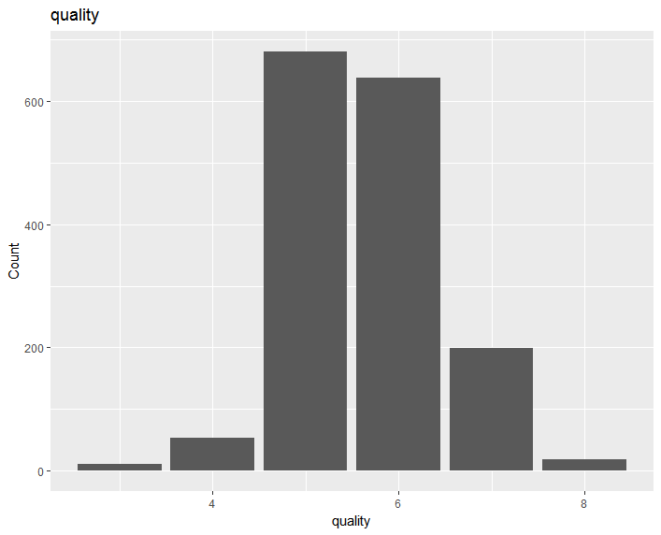
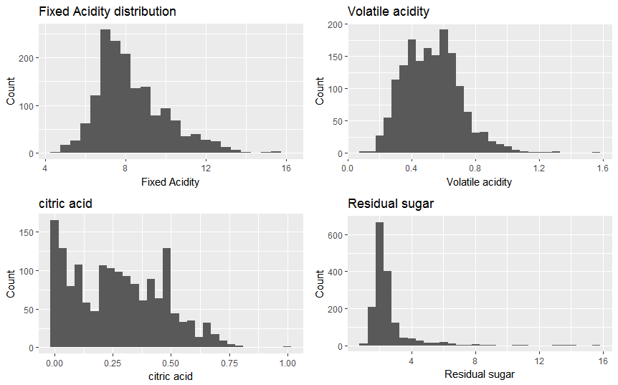

EDA
Notes:
## Target of this Project In this project, I will analyze the Red Wine Data and try to understand which variables are responsible for the quality of the wine. First I will try to get a feel of the variables on their own and then I will try to find out the correlation between them and the Wine Quality with other factors thrown in. Finally I will create a linear model to predict the outcome of a test set data.

Slide 6
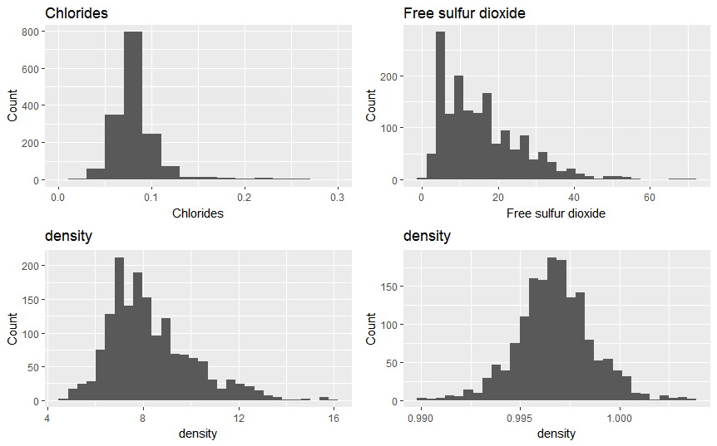
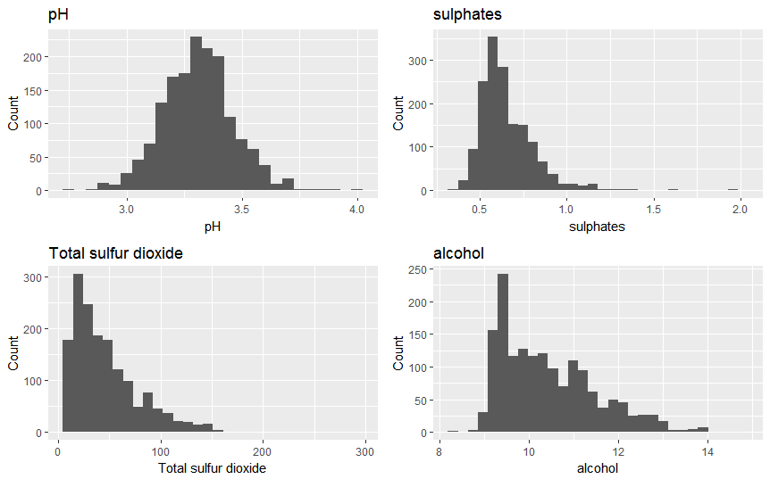
EDA
Notes:
## Target of this Project In this project, I will analyze the Red Wine Data and try to understand which variables are responsible for the quality of the wine. First I will try to get a feel of the variables on their own and then I will try to find out the correlation between them and the Wine Quality with other factors thrown in. Finally I will create a linear model to predict the outcome of a test set data.

Slide 7
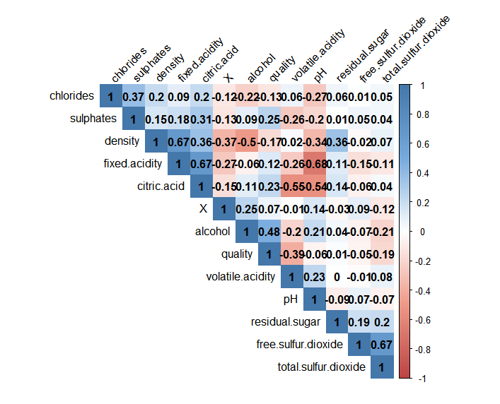
EDA
Quality
Alcohol,
Notes:
## Target of this Project In this project, I will analyze the Red Wine Data and try to understand which variables are responsible for the quality of the wine. First I will try to get a feel of the variables on their own and then I will try to find out the correlation between them and the Wine Quality with other factors thrown in. Finally I will create a linear model to predict the outcome of a test set data.

Slide 8
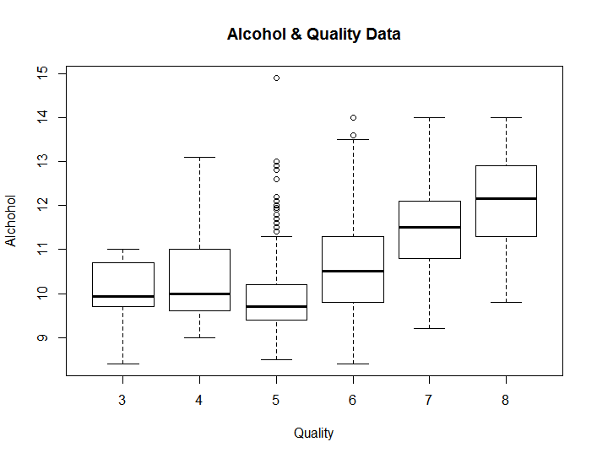
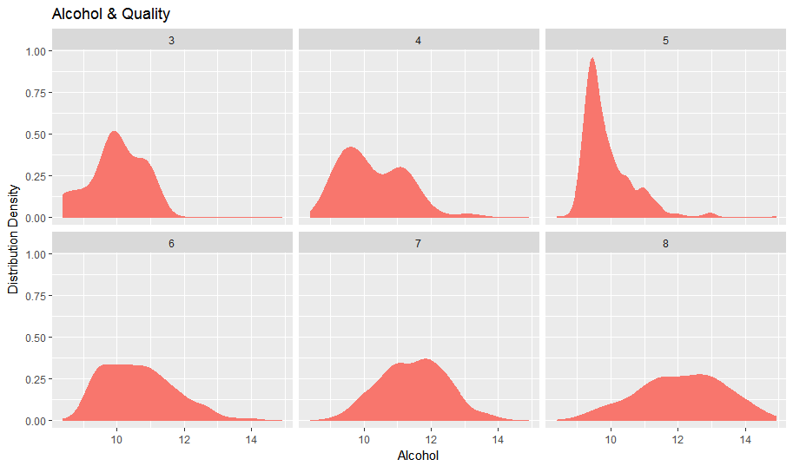
EDA
Alcohol by Quality Box
the better the wine, the lower the mean density.
Notes:
The picture of the Alcohol by Quality box shows that the better the wine, the lower the mean density.

Slide 9
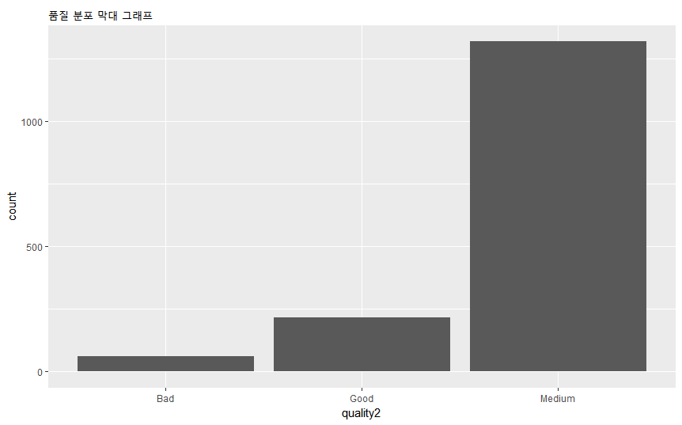
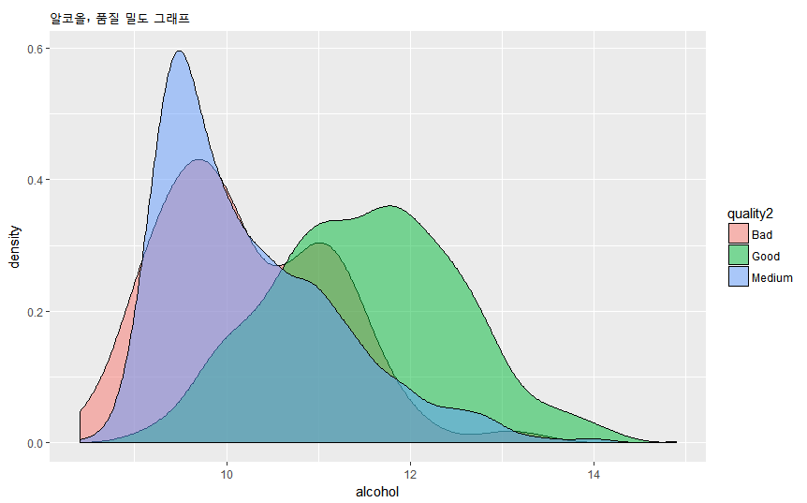

EDA
Bad, Good, Medium
3 <= Quality < 5 : Bad
6 <= Quality < 7 : Medium
7 <= Quality < 8 : Good
-> logistic regression analysis
Notes:
We conducted a logistic regression analysis to distinguish good , medium, bad quality

Slide 10
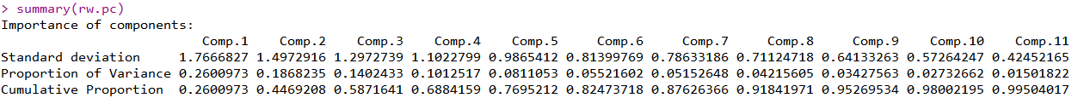
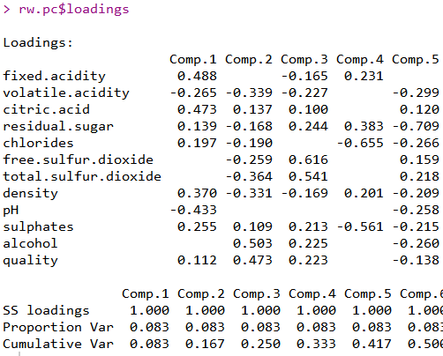
PCA

Slide 11
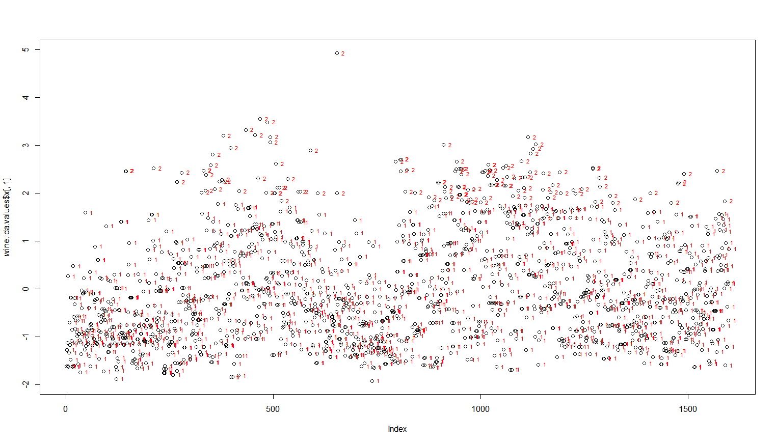
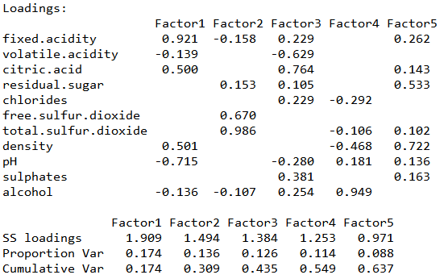
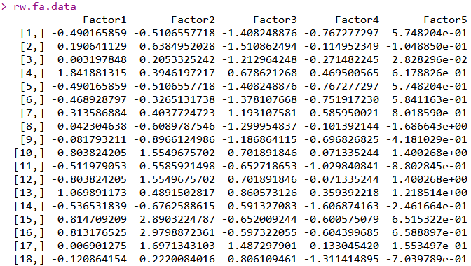
FA
# of Factor = 5
Fator1 : fixed acidity, density
Fator2 : 이산화황 sulfur dioxide
Fator3 : acidity
Fator4 : residual suger, density
Fator5 : 알코올 Alcohol

